Slide 1


Solutions Update
Brillio Analytics
October 24th 2019

Slide 2
Agenda
Solutions Overview
Artemis
DHI
CIP

Slide 3
Solutions Overview
SOLUTIONS THAT ARE MARKET READY
Vision Analytics
CaPS
EKG
Text Summarizer
SOLUTIONS THAT ARE IN PROGRESS
Artemis
DHI
DASH
SOLUTIONS THAT ARE IN THE PIPELINE
CDLS
CI Platform

Slide 4









ARTEMIS – Know your customer
What Makes It Relevant
1.
It is overwhelming to manually analyze customer feedback.
Manually collecting, prioritizing and making sense of requests is difficult and time consuming.
2.
Customers often ignore surveys sent to them.
External surveys have a 10-15% response rate. Internal surveys generally receive a 40% response rate.
3.
Customer preferences change over time.
Product managers end up making product decisions based on stale information.
4.
Wasted efforts on redundant enhancements.
Technology companies end up spending time on features that the customers are not interested in
5.
Targeted development based on customers opinion.
Customer feedback can be leveraged to know what is liked/disliked about the brand or a product
Helping You Identify Customer Sentiments in Real-time
12-32 Weeks
Feedback
from customer
Analyzed to identify topics & sentiment score
Notify
potential risk, unusual patterns
Generate actionable insights

Slide 5

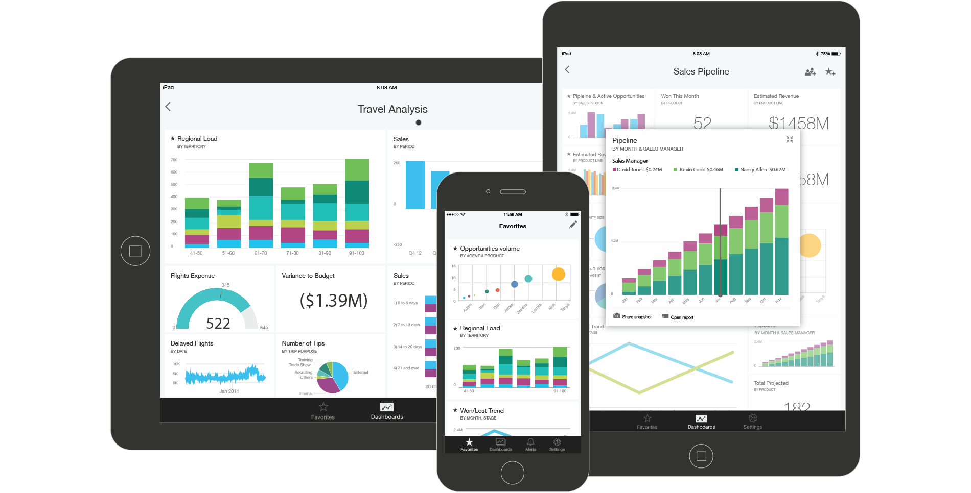


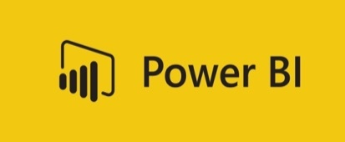




HOW THE SOLUTION WORKS
Secured Environment
Secure
API
Machine learning aspect classifier
Brillio’s ABSA engine
Customer Feedback received
Easy to read, responsive and insightful visualizations consumable on any platform
Aspects
Aspect sentiments
Words describing sentiment
DATABASE
5

Slide 6

THE ANALYTICS IN THE BACKGROUND
Deep Learning for Aspect-Based Sentiment Analysis (ABSA)
Overall training Approach
Step 1
Step 2
Step 3
Data Pre-processing
The un-structured (text) data is labeled (Multi-class Multi – Label)
If adequate labels are not available, use weak supervision
Aspect Category
Identify every Aspect mentioned/alluded to in the given text.
Eg: Display, Processor for Laptops
These are customized based on domain.
Sentiment Polarity
Each identified Aspect in the given text is assigned a polarity.
A sentiment score is classified as positive, negative or neutral.
ABSA Model Build
Word Vectors
“powerful processer”
“Long Battery Life”
“Excellent Display”
Dependency Parser
Aspect-based Sentiments
Aspects
Aspect Sentiment Model
Aspect Classification Model
Recurrent neural network
with transfer learning
Glove word embeddings
Lexicons
Notes:
https://cs224d.stanford.edu/reports/WangBo.pdf

Slide 7

THE ANALYTICS IN THE BACKGROUND
Finding the sentiments pertaining to each aspect in the product
Machine Learning based Aspect Classifier
Brilllio Aspect Based Sentiment Analysis Engine
Leveraging NLP techniques for the mapping of feedbacks to corresponding aspects:
Multi-class entity classifier
Aspect mapping
Techniques: RNN, word embeddings
Sentiment attribution to each of the detected aspects:
Sentiment Classification
Sentiment scoring
Techniques: dependency parser
Model Intelligence Enhancement techniques
Custom word embeddings
Adding unique terms with a particular aspect
Human-in-the-loop feedback mechanism within the tool to improve model results
7

Slide 8




CURRENT VS FUTURE STATE
THE CURRENT
1.
Business user is looking for information
User creates request for new ad-hoc report
2.
BI Team needs to gather requirements
BI Team spends time with business user to understand what insights they seek
3.
Data preparation & model to be built
Data engineering team works on data prep and semantic model development
4.
Report build & publish
BI Report development and deployment takes few weeks/months to develop depending on the complexity
5.
Future changes in business requirements
The answers business users seek from their data rapidly evolves
THE FUTURE
12-32 Weeks
Business User asks DHI a question in natural language (text/voice)
The question is analyzed by DHI
DHI searches through the Database to find the relevant information
DHI converts the data into visuals that rapidly provide answers
Users can craft their own stories on DHI and change their story as often as they change their mind

Slide 9

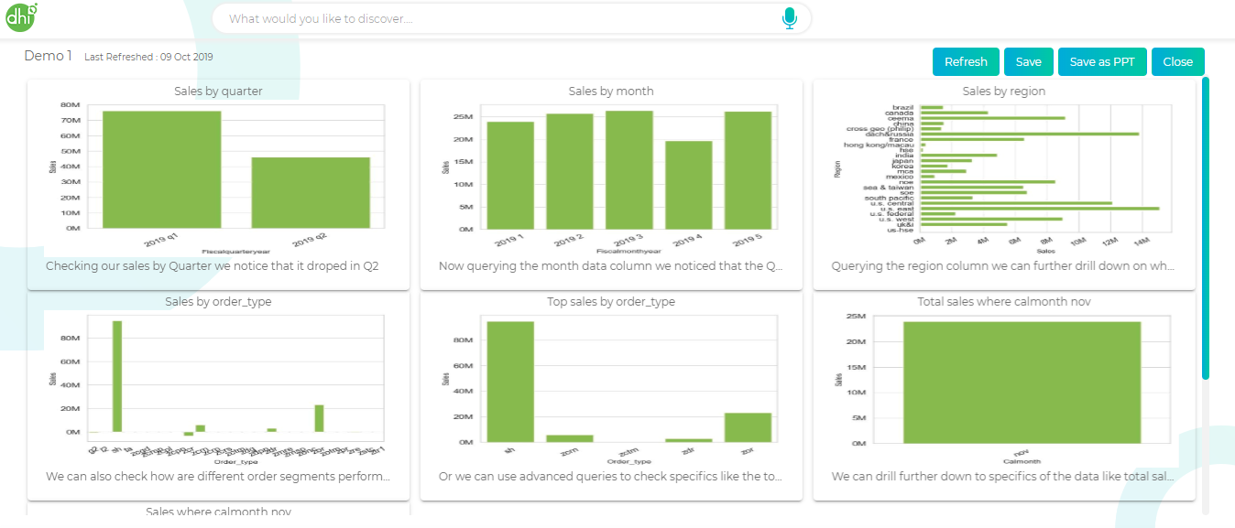

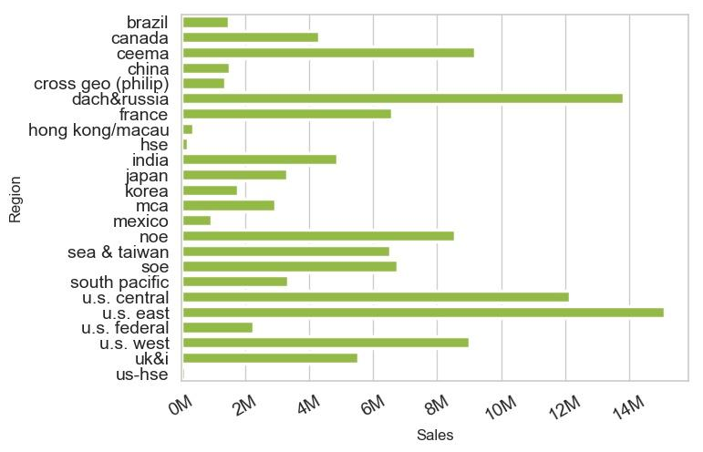


HOW IT WORKS
VISUALIZATION RENDERER
Voice or text input
Data converted into user-friendly visuals
Max searches for a query on DHI
Query converted to a machine-readable format
Easy to read, responsive and insightful visualizations
User crafted story board built from Dhi generated visualizations
GRAPH REASONER
QUERY ANALYSER
Query intelligently optimized for ETL context
Data converted into a BI friendly format
ETL Interactions
Retrieve and incorporate user preferences
Handle exceptions and ambiguity
Identify lexical patterns and decipher meaning
Decode grammar rules
Retrieve and incorporate “knowledge”
Decipher context and accurately identify query variables
ETL Interactions
9
DATABASE

Slide 10


SOLUTION VISION FOR CONSUMER INSIGHTS PLATFORM
“ To help CPG brands truly map out their consumer preferences, business trends, competitor performance, and white space opportunities through a suite of tools, services and data sets “
10

Slide 11
SOLUTION FEATURES
DATA INTEGRATION HUB
Harmonizes data from disparate sources
INSIGHTS NOW
Current snapshot of consumer preferences
FUTURE FORWARD
Predictive view of trends and impact on KPIs
APIs to integrate data sources
Competitive landscape dashboards
Market share driver model
Data mart with consolidated KPIs and metrics
Micro-segmentation
Early warning prediction
Standard architectures for Data Lake
Voice of the Consumer
Preference network graph
11

Slide 12
Solutions Update
Appendix

Slide 13
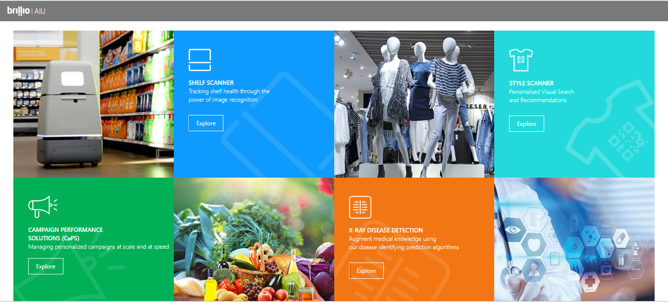
Centralized Repository of all Analytics AI Demos

Slide 14
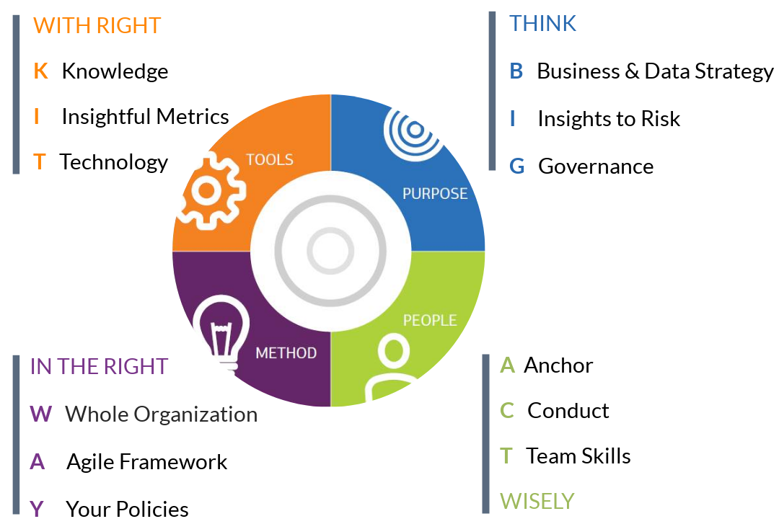





DASH (Data Analytics Strategic Harmonization)
Maturity
Architecture
Roadmap
Business Case
Target Operating Model
1
2
3
4
5
Governance Model
Analytics use cases
Risk &
Mitigation Strategy
Visualization Optimizations
Change Management Plan

Slide 15





CaPS (Campaign Personalization Solution)
Intelligent Optimizer
(R&D)
Value assessment study
Multi-arm bandit approach to campaign spend optimization
Gap identification
Co-creation of personalization story
Innovation roadmap
CaPS Core Services
Campaign measurement console
Know your customer
CLTV
Churn scores
Product loyalty
Share of wallet
Life stage models
BI dashboards
Uplift models
A/B testing measurement
Automated test and control strategies
Smart campaign assembly
CRM and MA integration
Pre-defined EDA templates
What-if models
ML driven personalization templates
Offer Execution
Offer Design

Slide 16
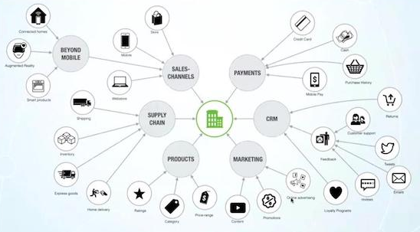
Enterprise Knowledge Graphs: uncovering hidden insights
Managing and Making Sense of Unconnected Data to uncover valuable hidden insights
What is a Knowledge Graph?
Represents a collection of interlinked entities where:
Entity Description has a formal structure that can be processed efficiently and unambiguously
Entities are interconnected to form a network
Delivers powerful search and discovery applications to understand the complete picture of an ecosystem
Examples
Creation Framework
Market Intel.
Employee Entity
Customer 360
Algorithms used:
Fundamentally involves Natural Language Processing (NLP), text mining, and machine learning
Entity & Scope Resolution, Hidden Markov Models, Conditional Random Fields, k-Nearest-Neighbors, and SVMs
EKGs can be used as an in-house application or as Software As A Service to customers

Slide 17
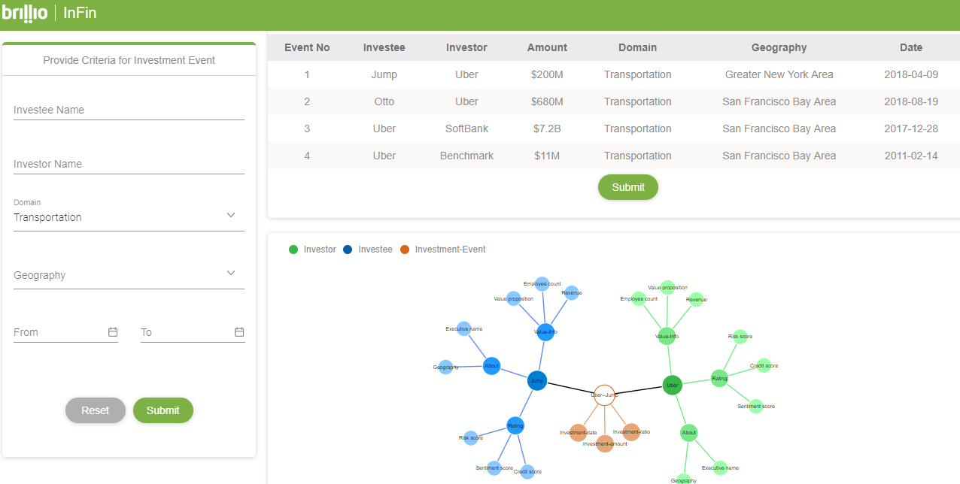
Enterprise Knowledge Graph Illustration

Slide 18

A Brillio Presentation

